Slide 1
Measurement of differential production cross section for high-pT top quarks in proton-proton collisions at 13 TeV
(l+jets & hadronic ttbar decay channels)
LHCtopWG
14 May 2020
(hadronic team)
G. Bakas (NTUA), K. Kousouris, G. Paspalaki (NCSR Demokritos), G. Tsipolitis
(𝑙+jets team)
Susan Dittmer, Louise Skinnari, and Julia Thom (Cornell University)

Slide 2


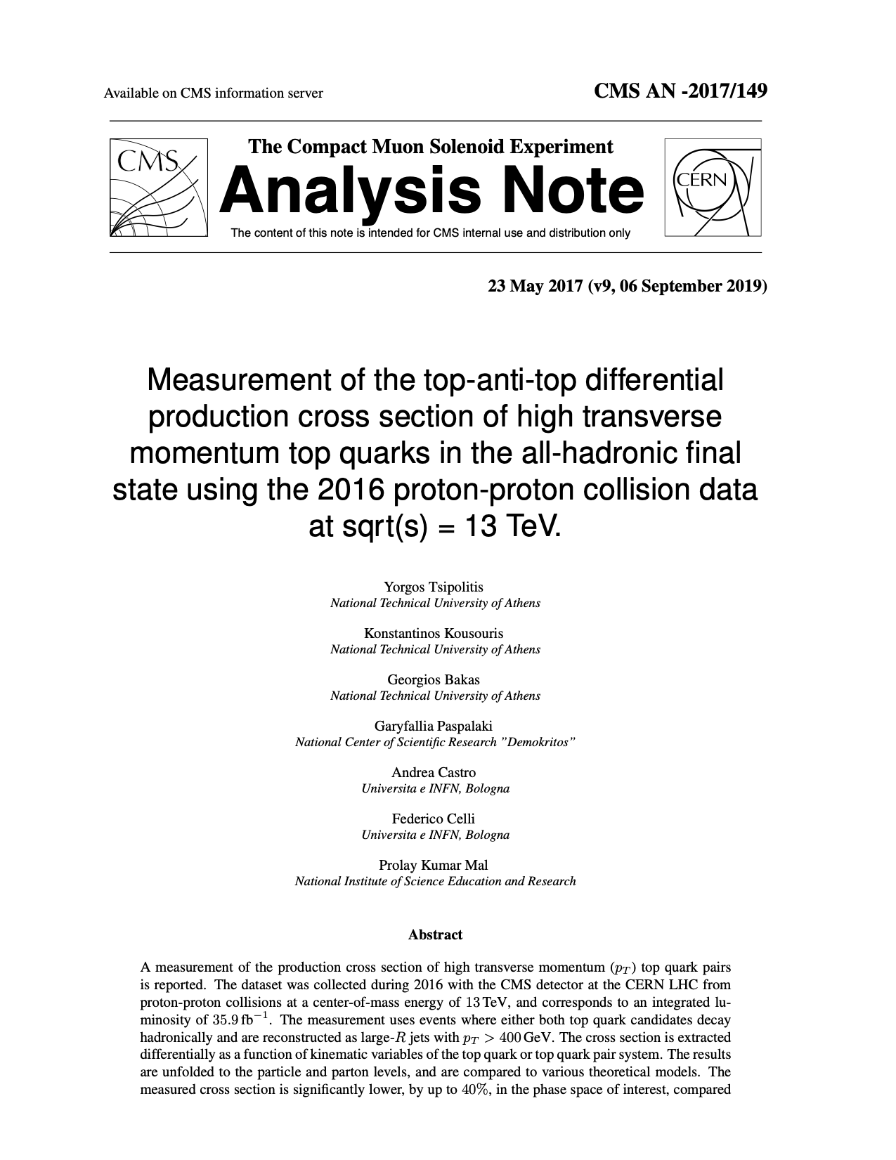
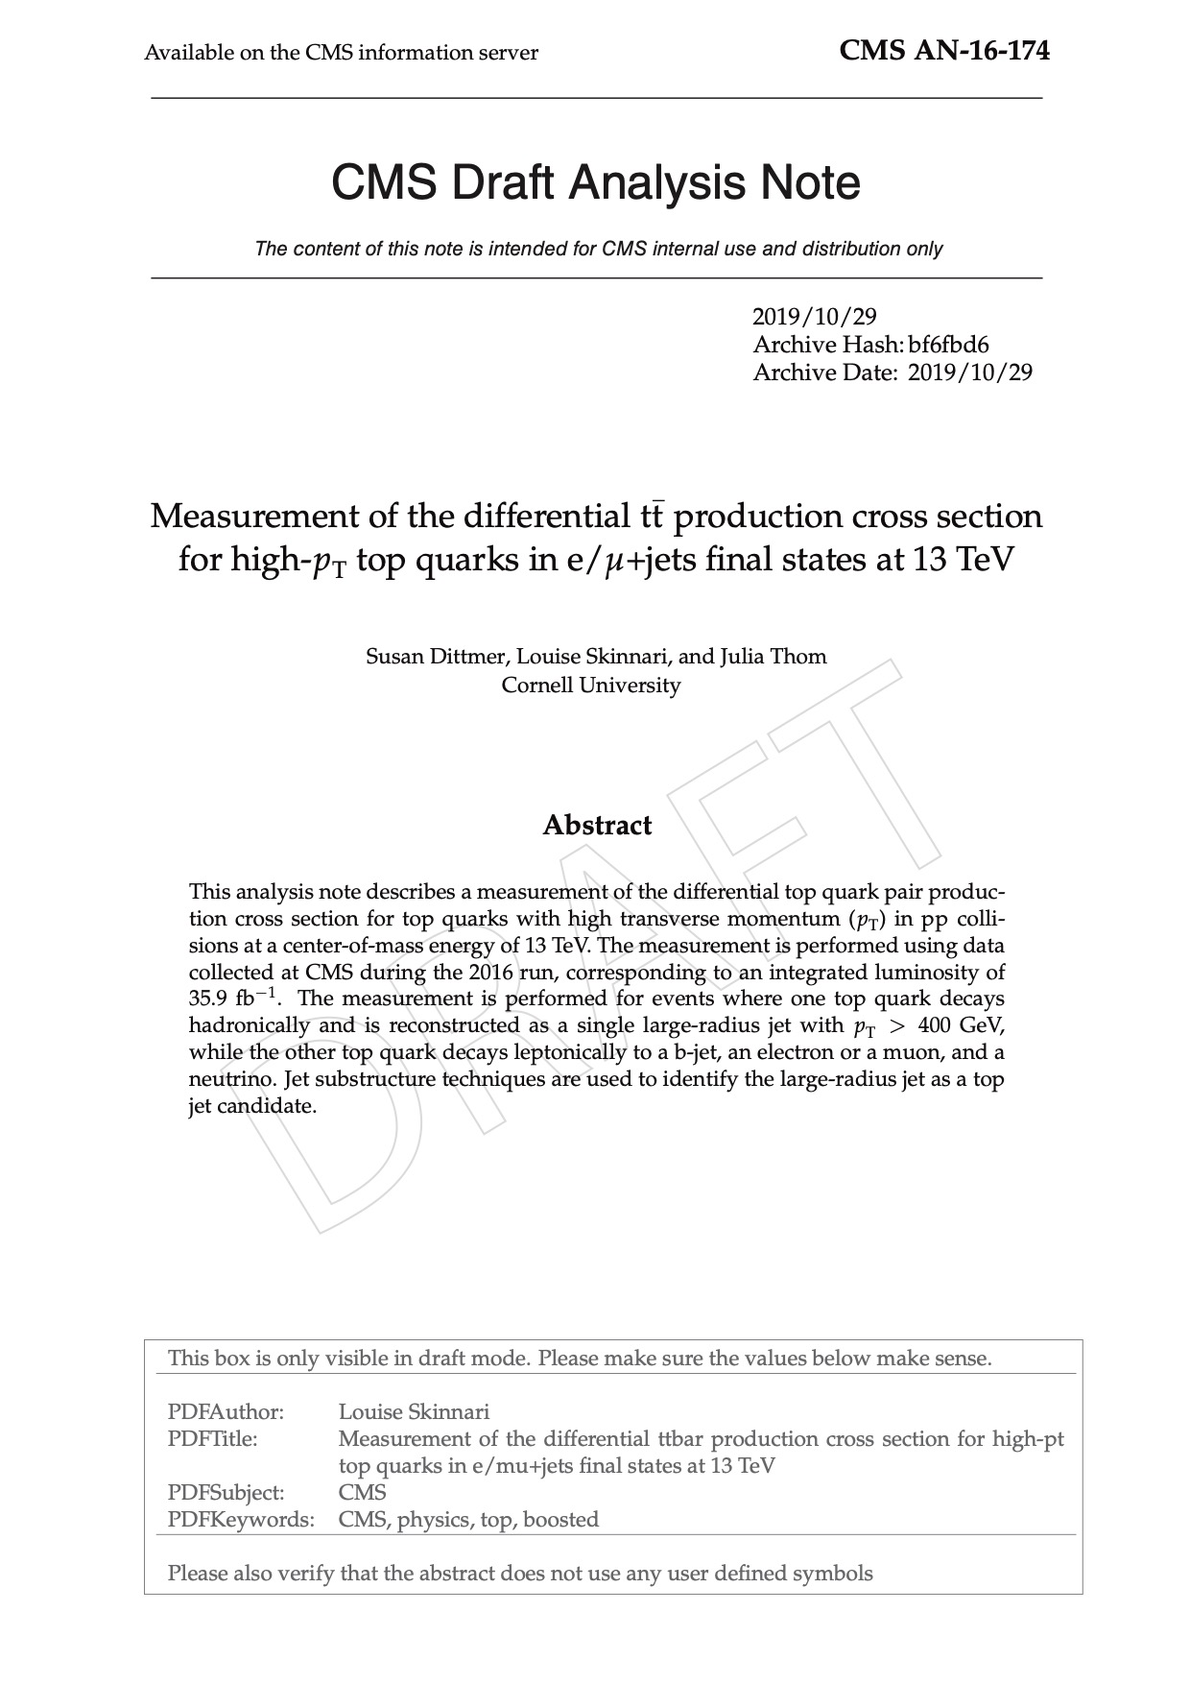

Documentation
AN-2017/149
AN-2016/174
hadronic
𝑙+jets
TOP-18-013
https://twiki.cern.ch/twiki/bin/viewauth/CMS/TOP18013

Slide 3
Analysis overview
3

Slide 4
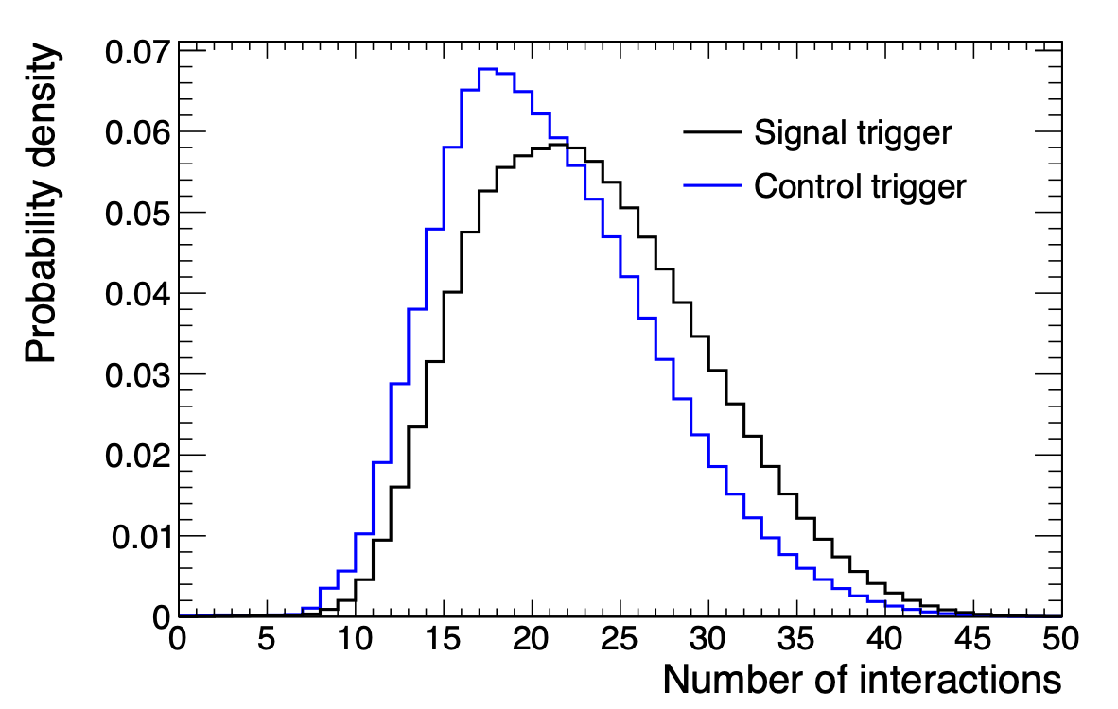
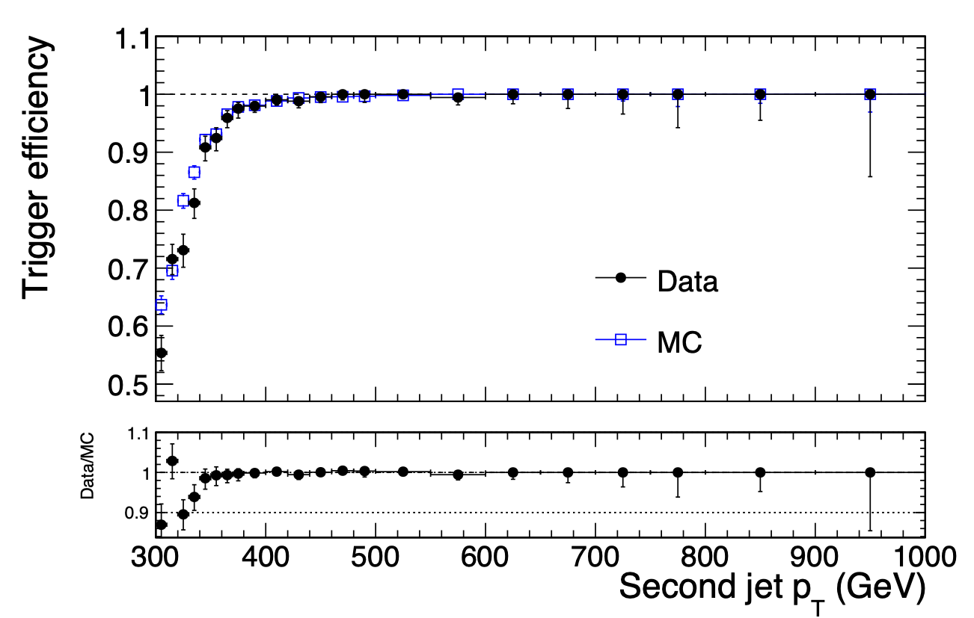
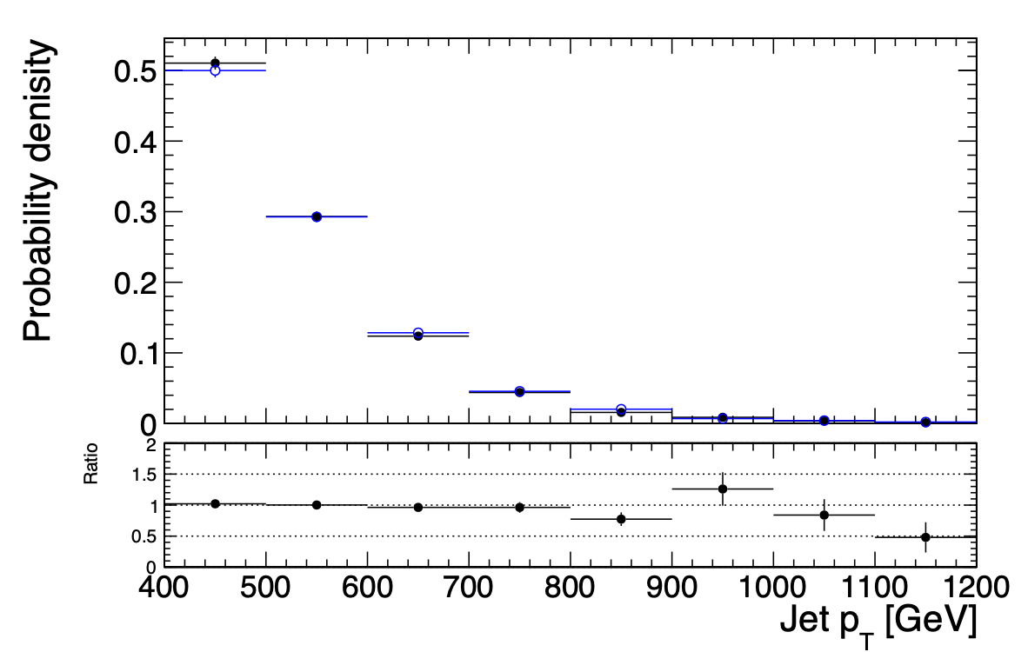
Trigger
Signal path: HLT_AK8DiPFJet280_200_TrimMass30_BTagCSV_p20
unprescaled: 35.9 fb⁻¹ luminosity
efficiency measured wrt orthogonal muon trigger
Control path: HLT_AK8DiPFJet280_200_TrimMass30
same kinematics, no HLT b tagging
prescaled: 1.67 fb⁻¹ luminosity
somewhat lower pileup profile (analysis not sensitive to pileup)
Analysis region

Slide 5
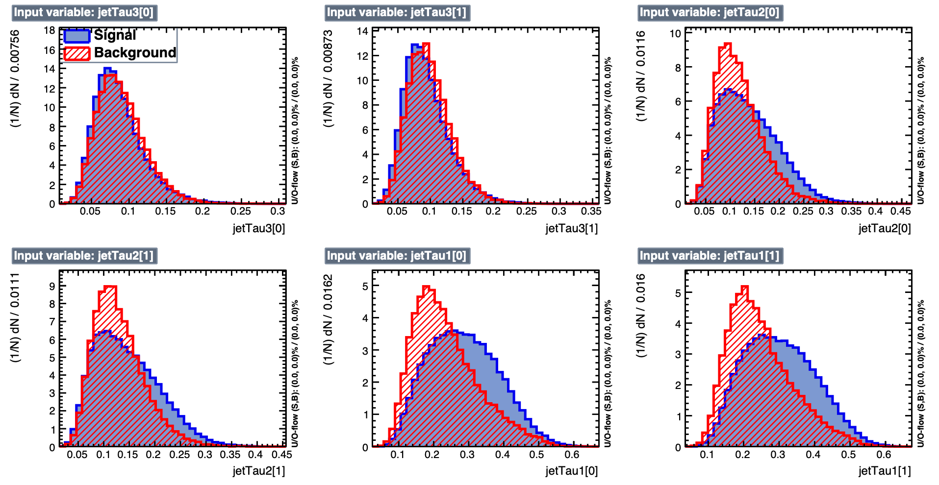
Multivariate discriminant (variables)
“ttbar tagger”
N-subjettiness τ1,2,3 for both jets

Slide 6
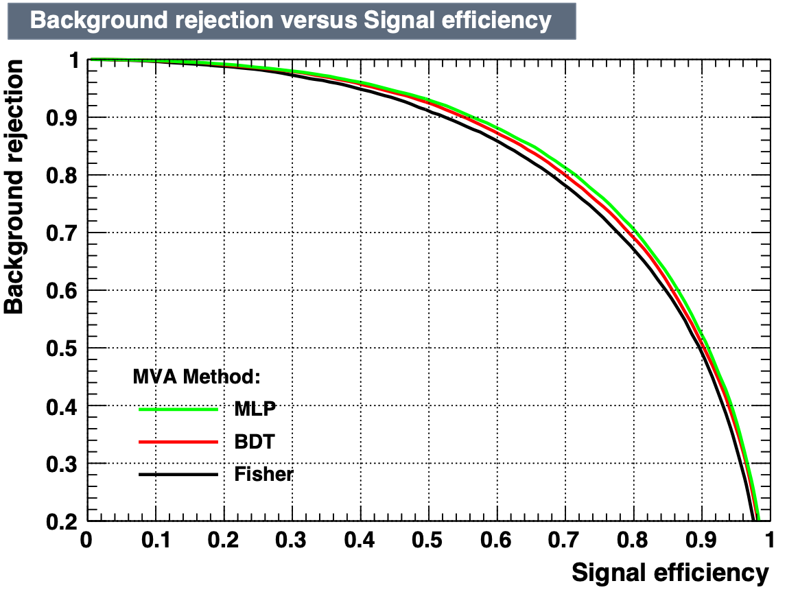
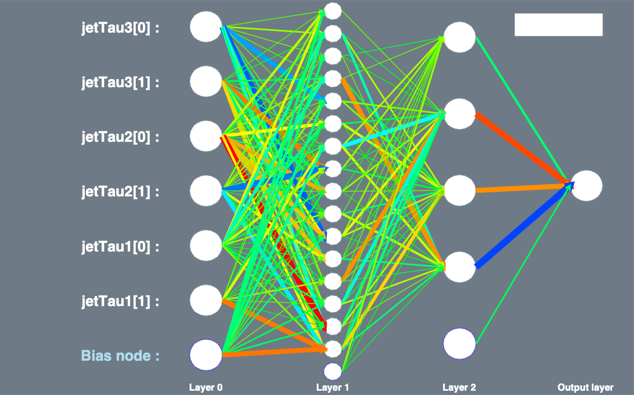
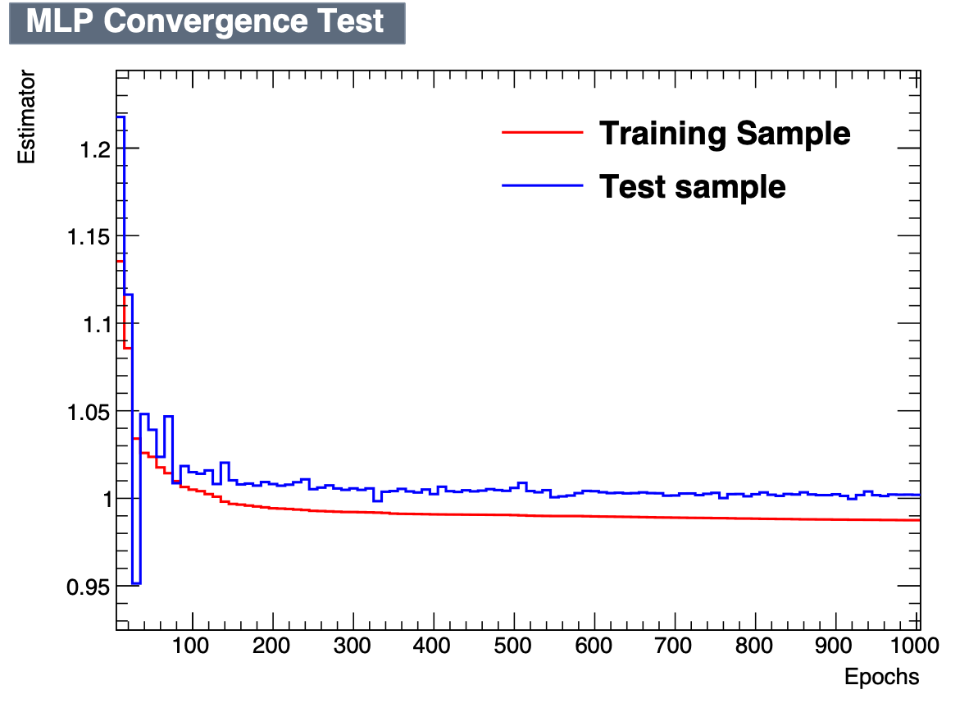
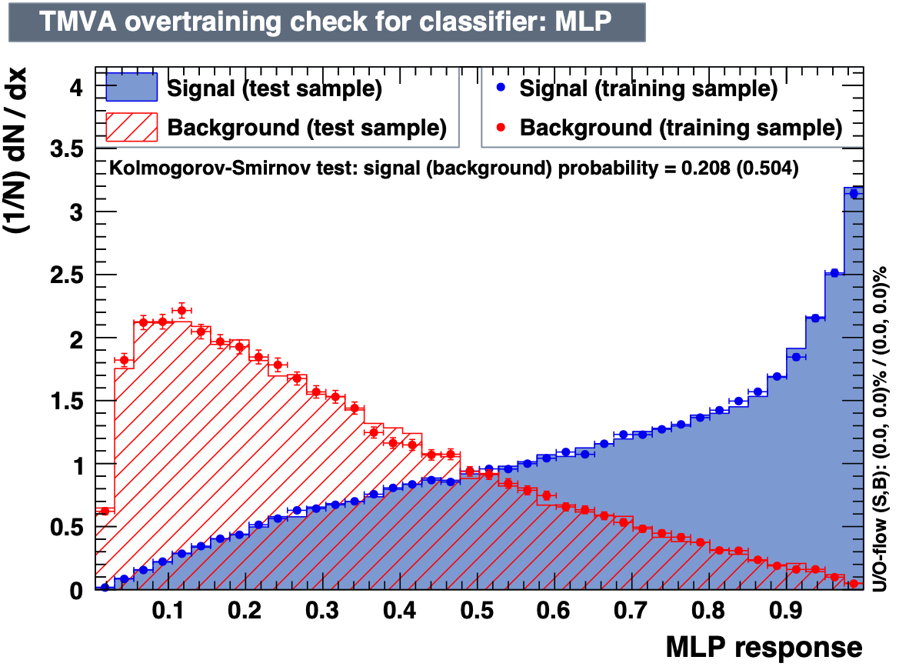

Multivariate discriminant (training)
CUT

Slide 7
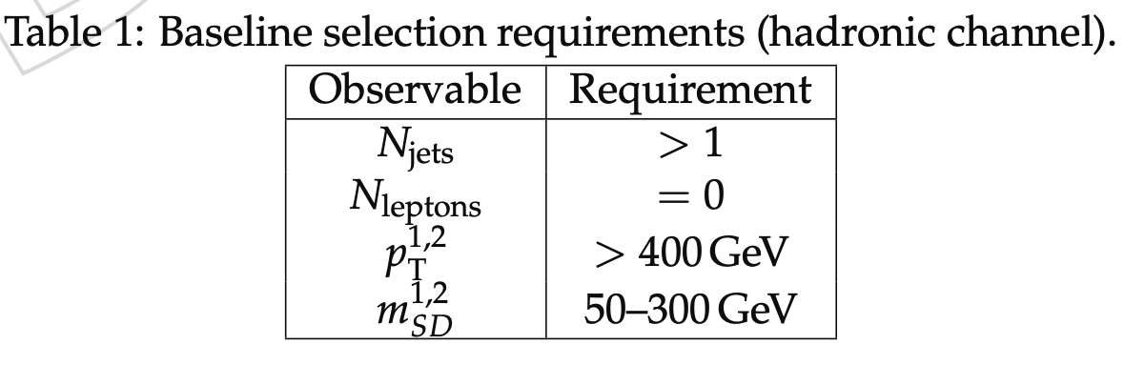
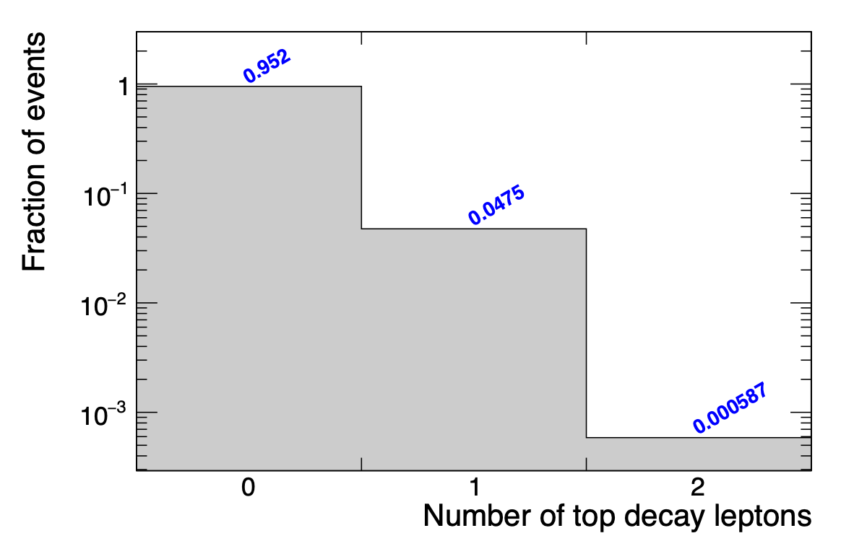


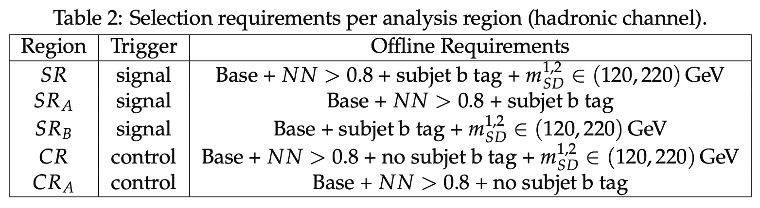
Selection
jets: AK8 PF+CHS
signal region: 95% hadronic decays
NN CUT (0.8)
compromise between enough tt events and signal purity

Slide 8
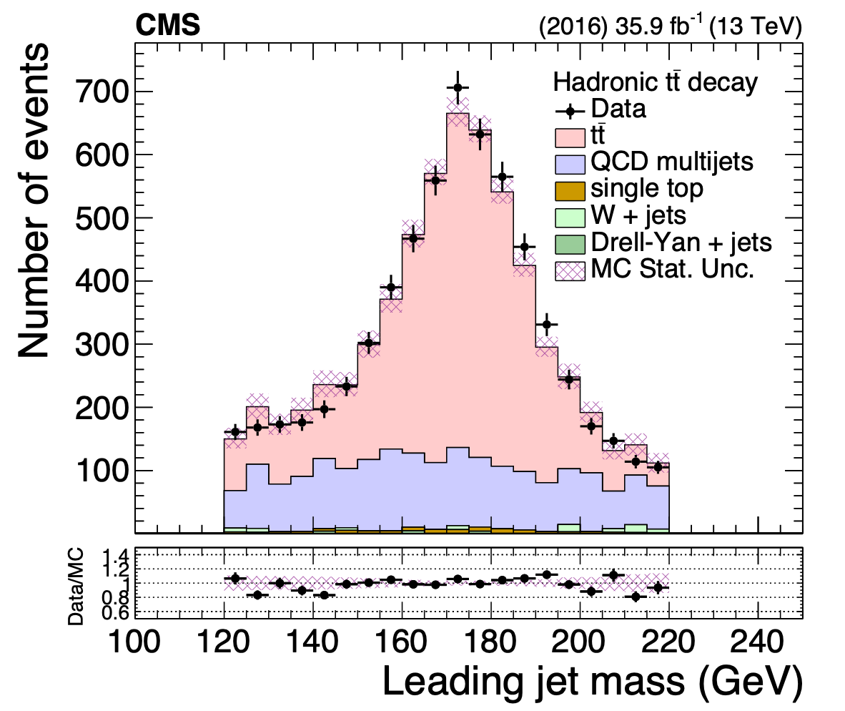
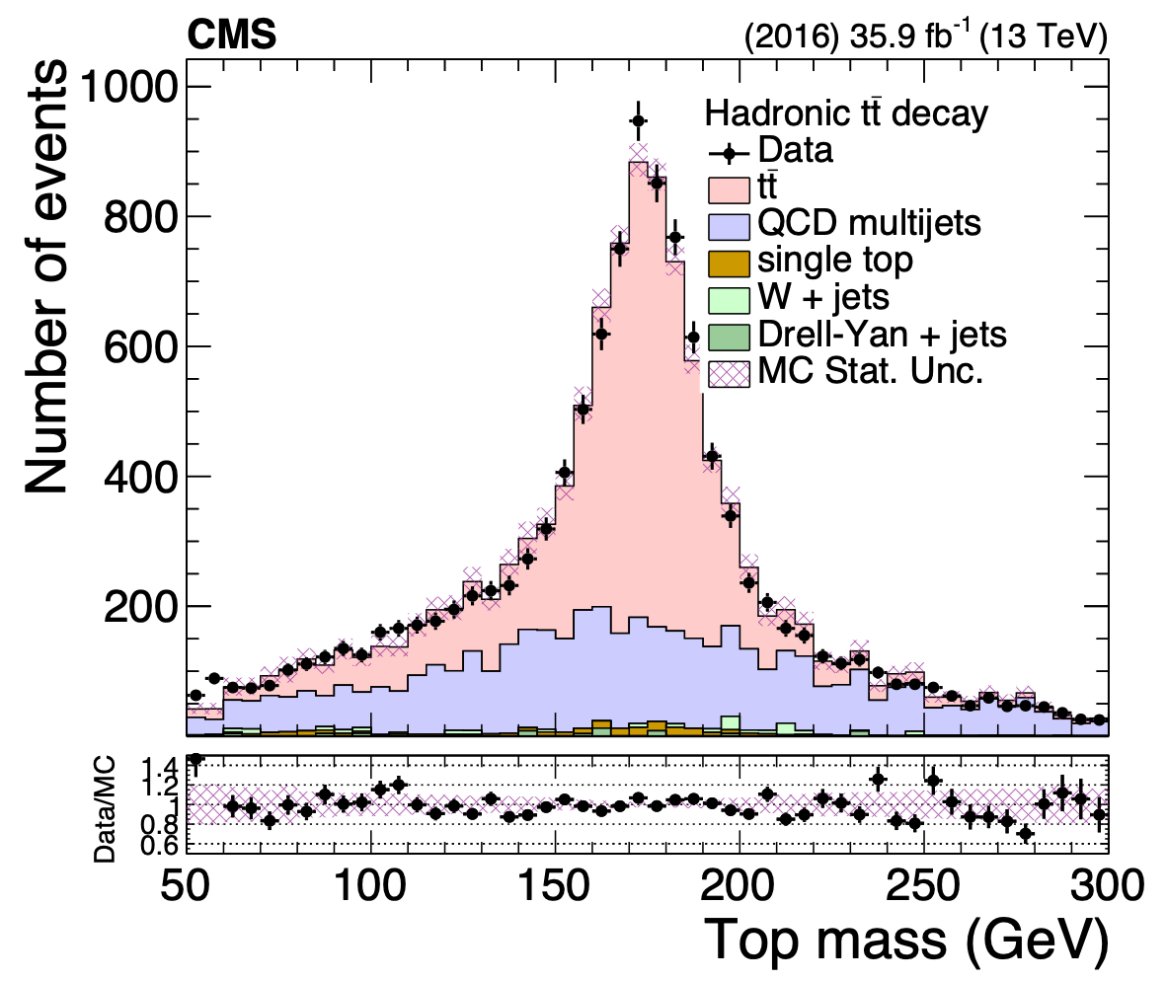
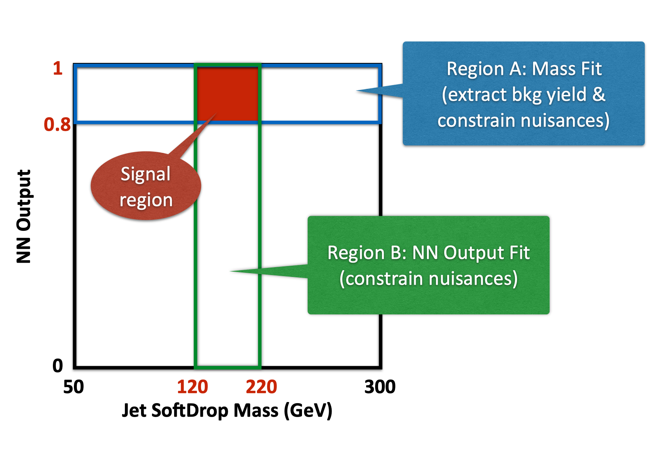
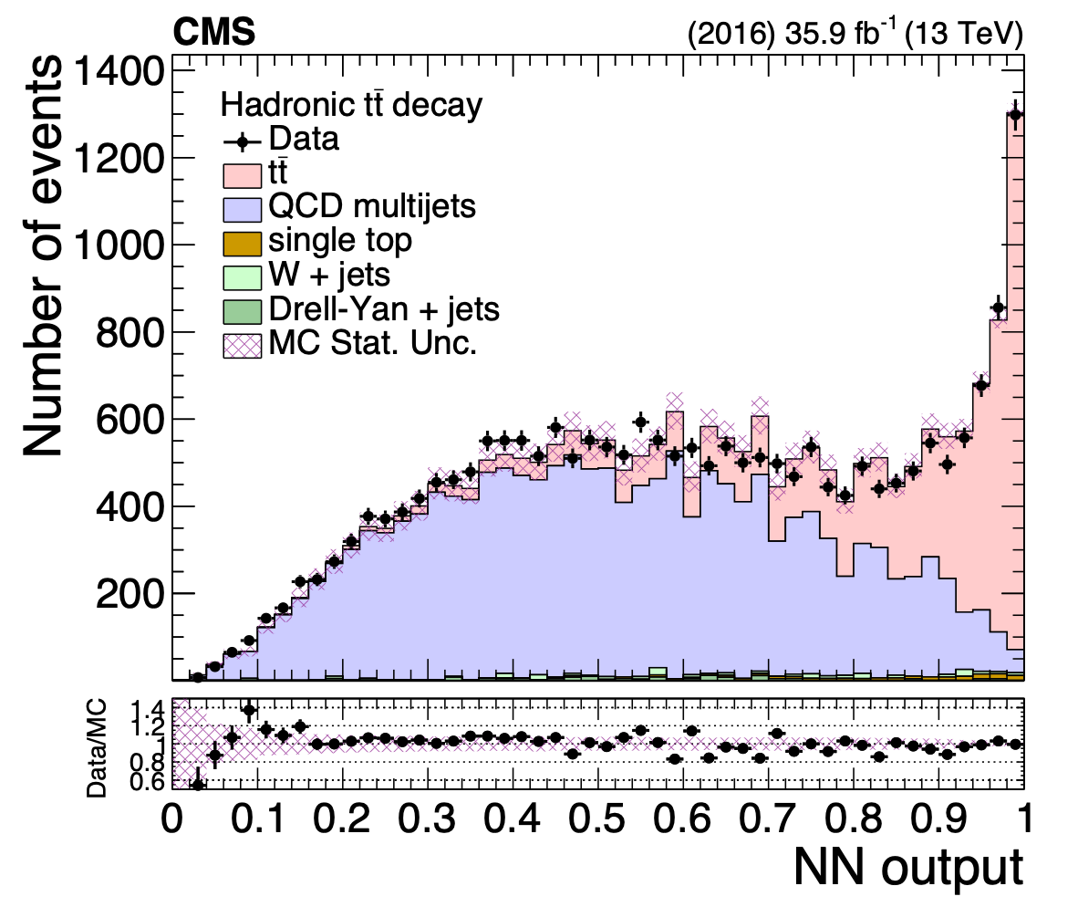
Analysis regions
paper

Slide 9
Signal extraction
fiducial yield
Transfer factor from SRA to SR (taken from CRA/CR data)
Bkg shape
(taken from CR in data)
Data
Bkg yield
(fit in region SRA)
Bkg shape correction
(taken from MC)

Slide 10
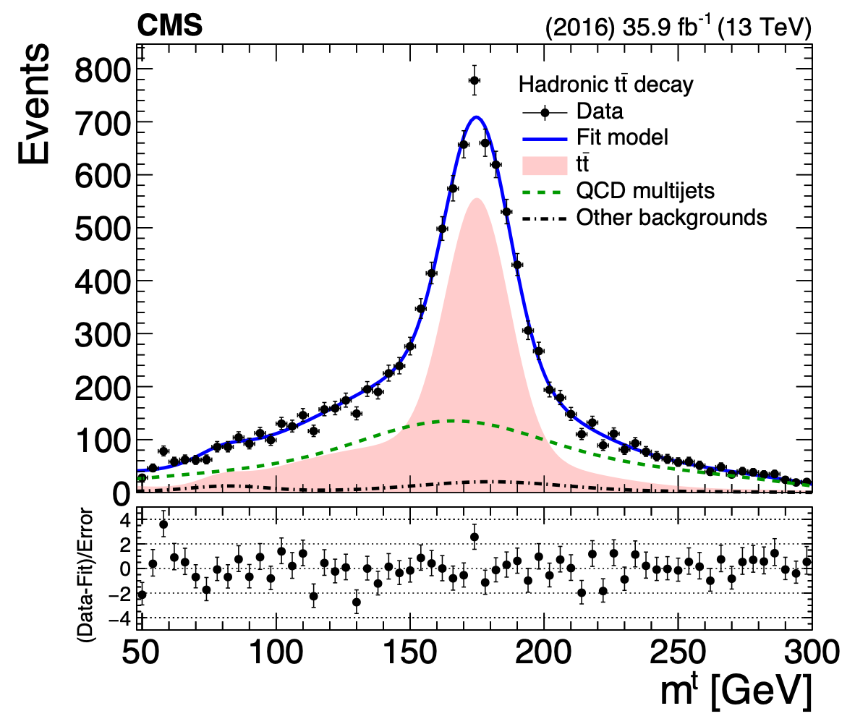
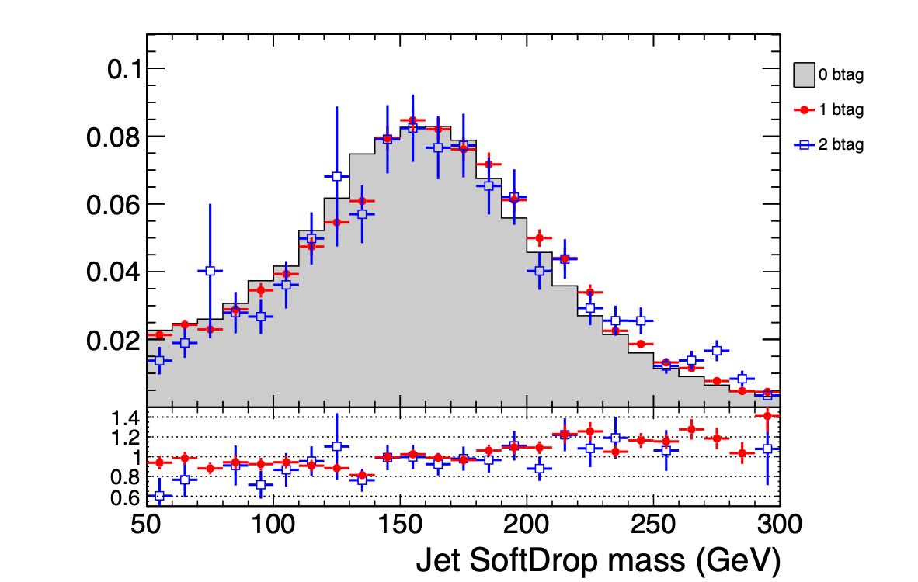
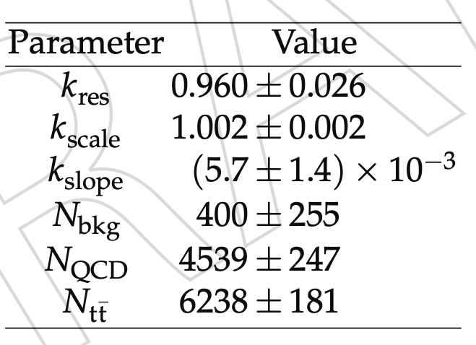
Fit in SRA
MC QCD closure
paper
Process | SRA (pre-fit) | SRA (post-fit) | SR (pre-fit) | SR (corrected)
ttbar | 9853 | 6238 | 6685 | 4245
QCD | 5346 | 4539 | 2248 | 1876
single top | 215 | 215 | 83 | 83
VJets | 185 | 185 | 71 | 71
Data | 11145 |  | 6274
rtt = 0.63

Slide 11
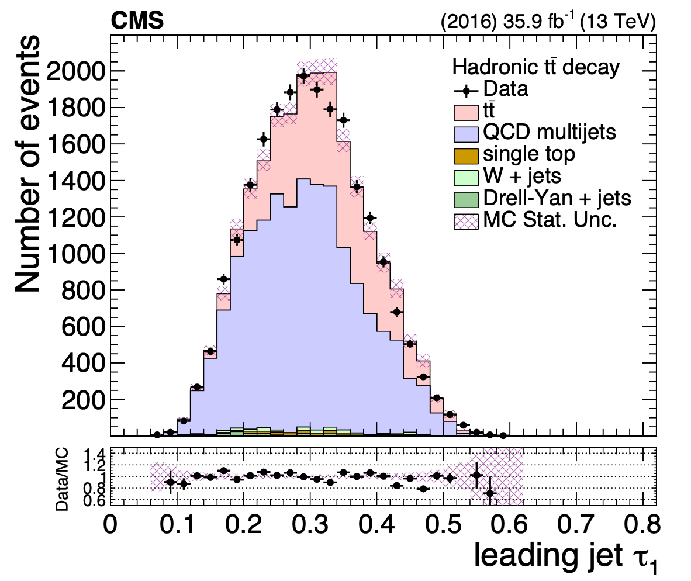
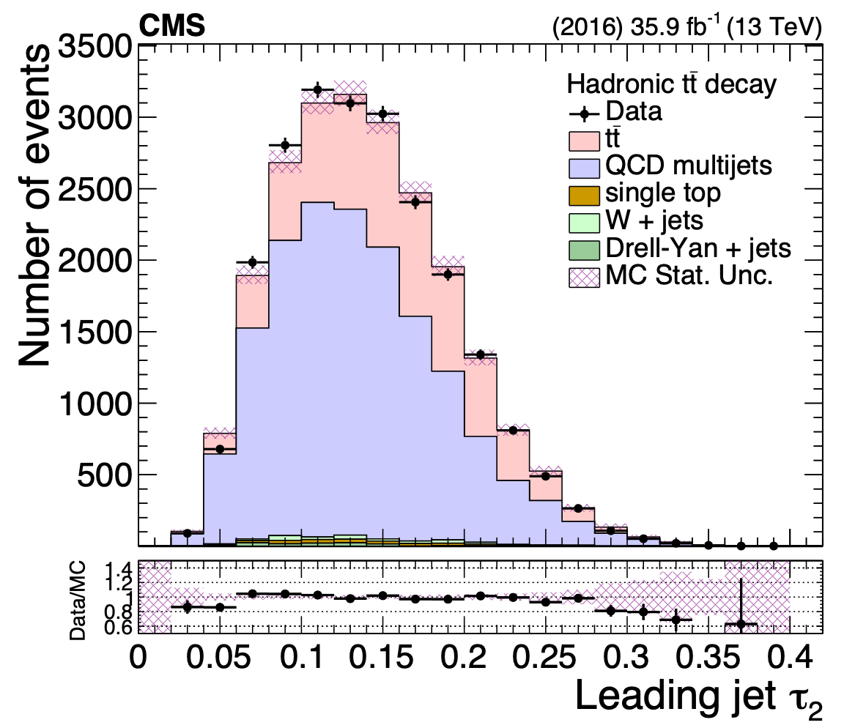
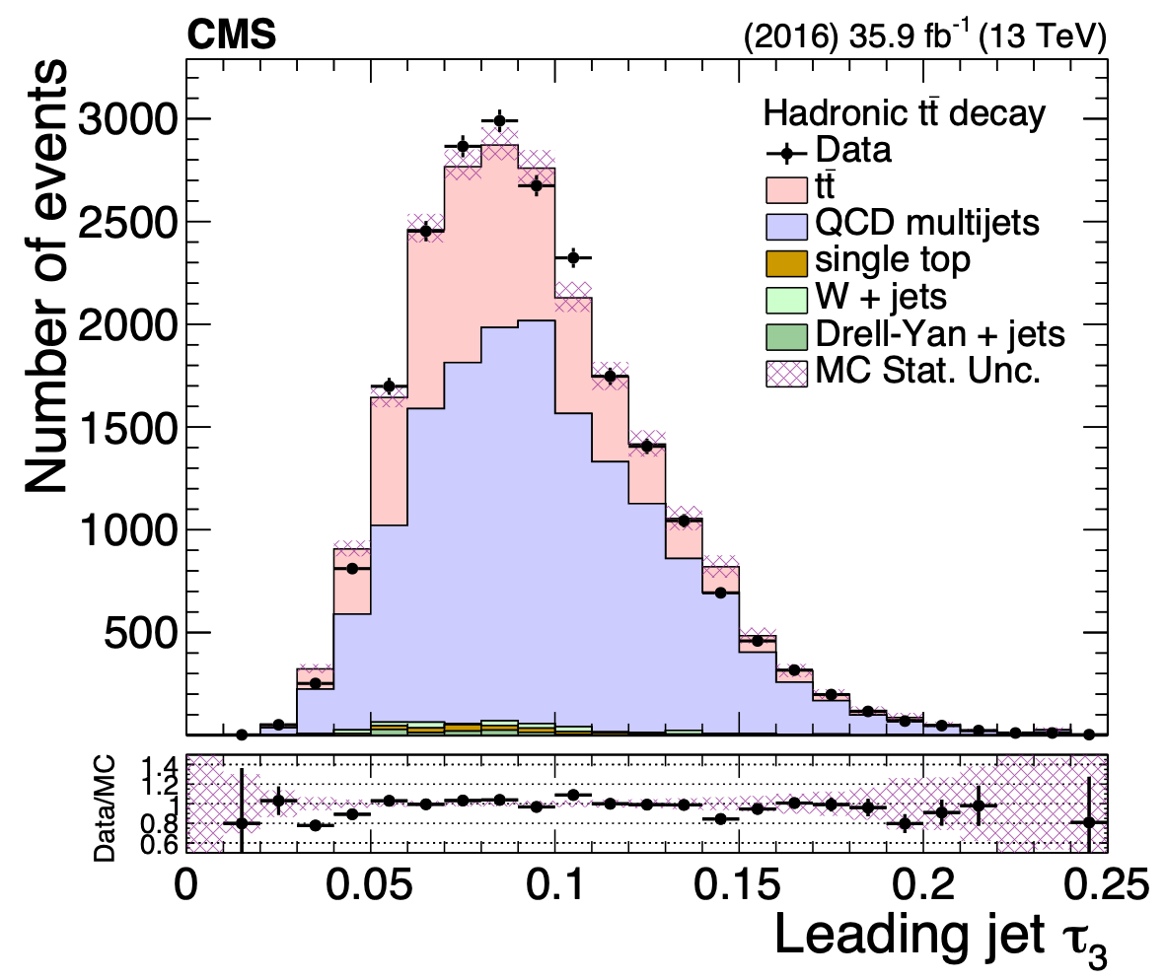
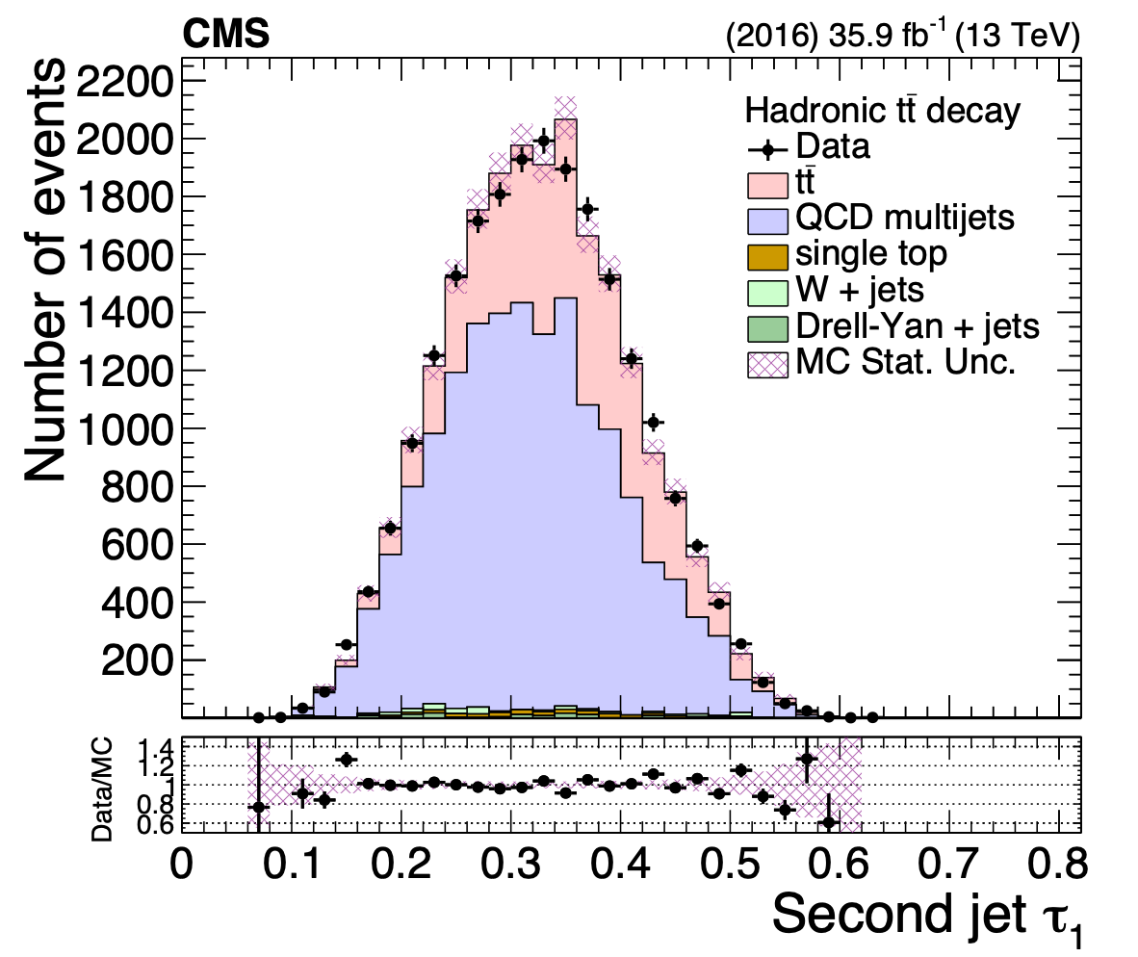
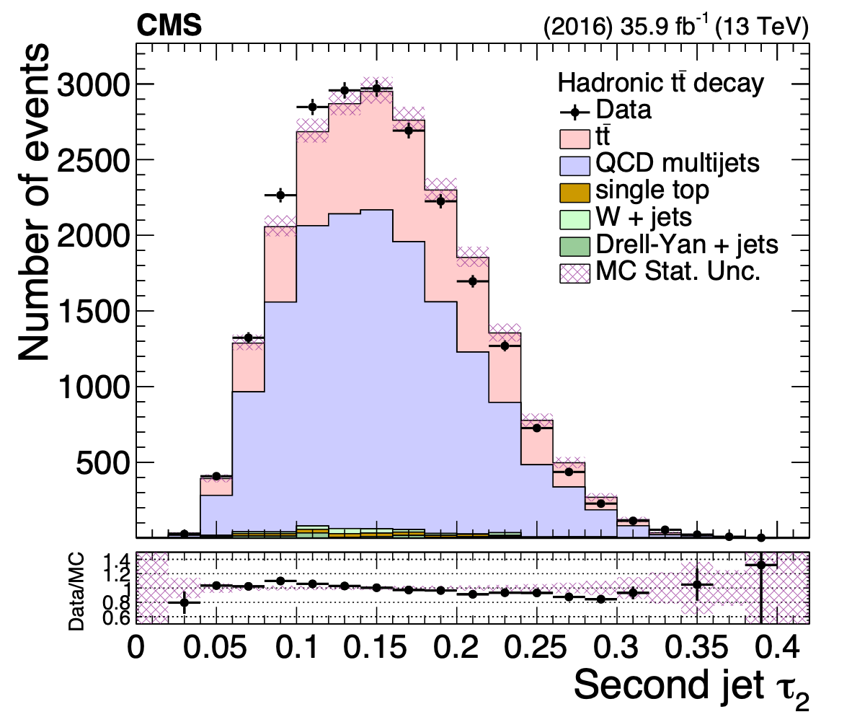
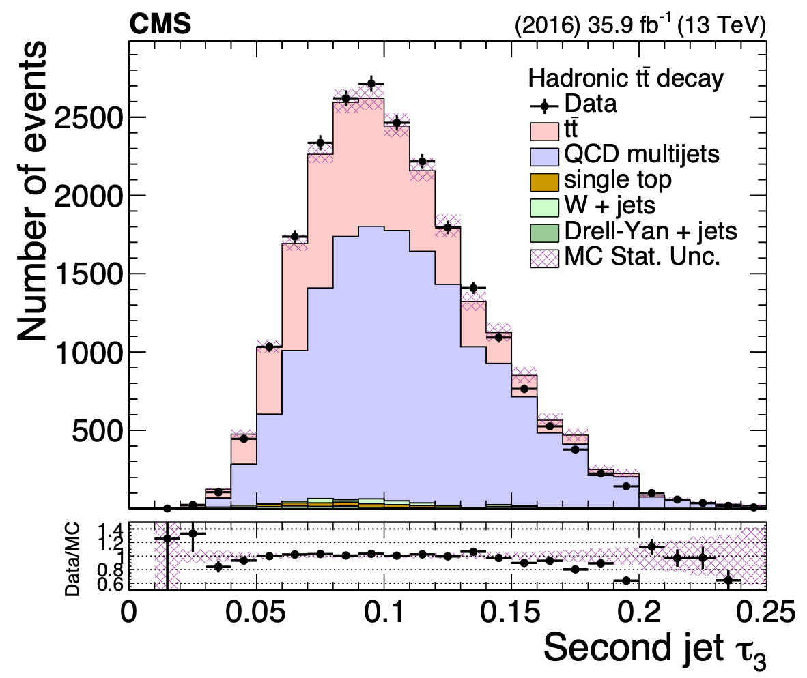
Substructure properties (before NN cut)

Slide 12
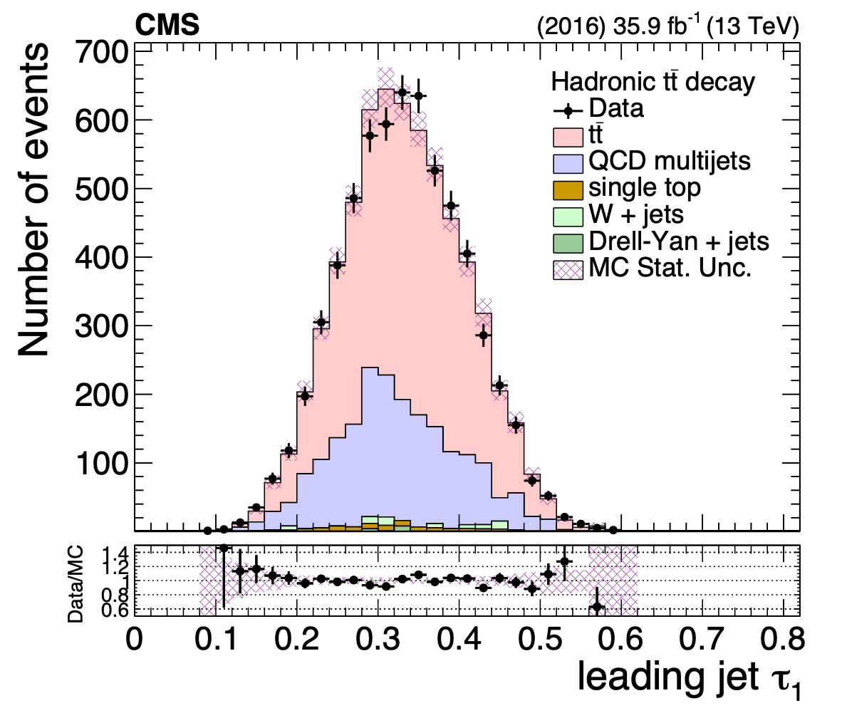
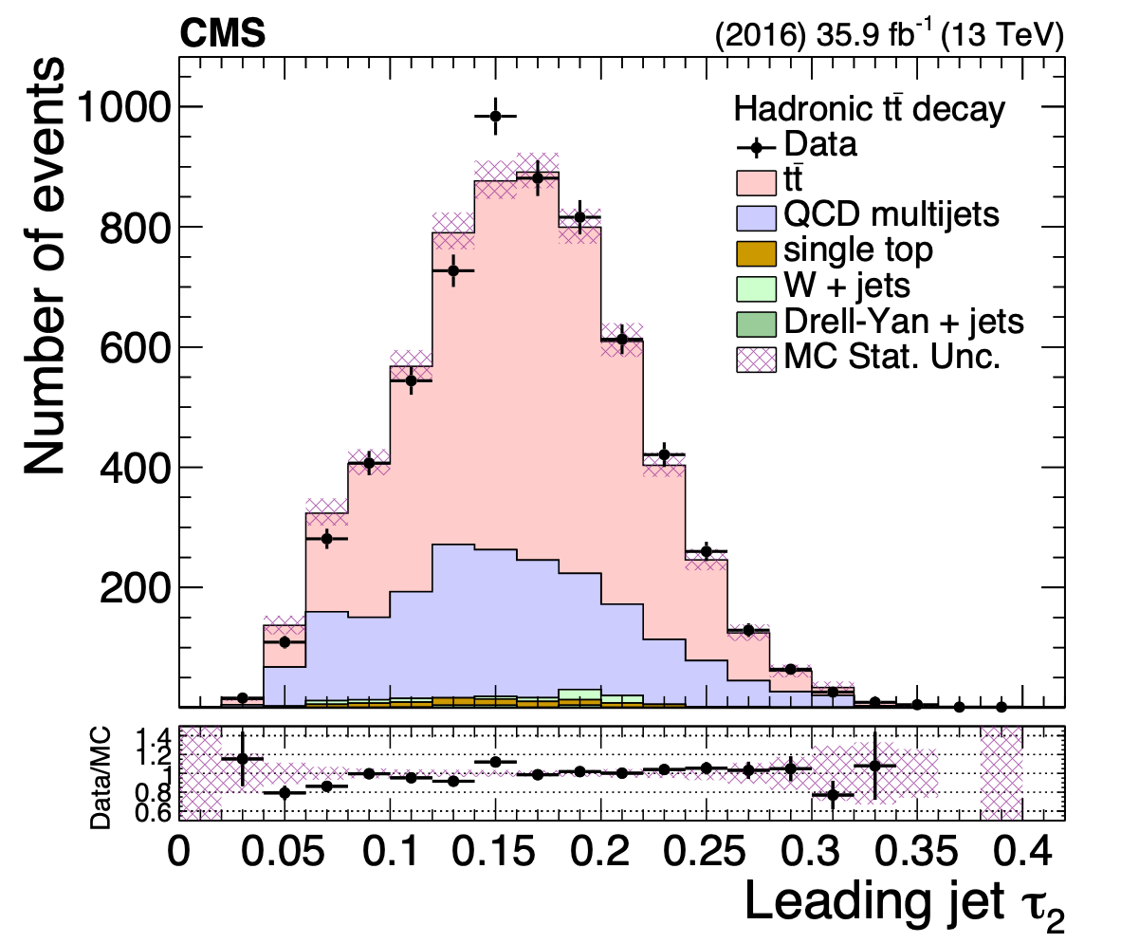
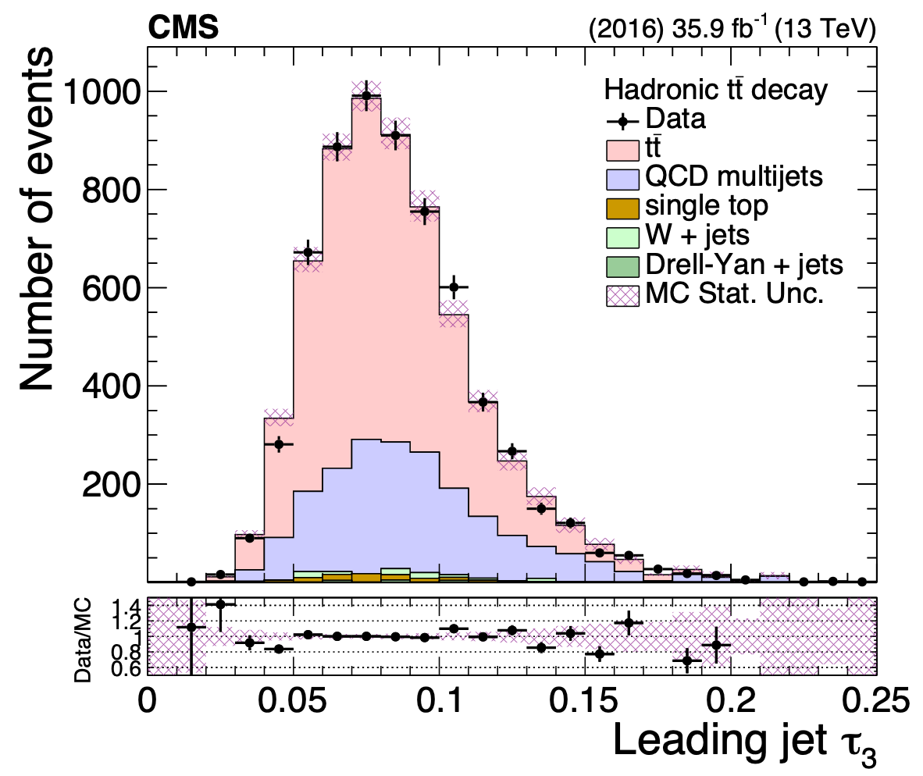
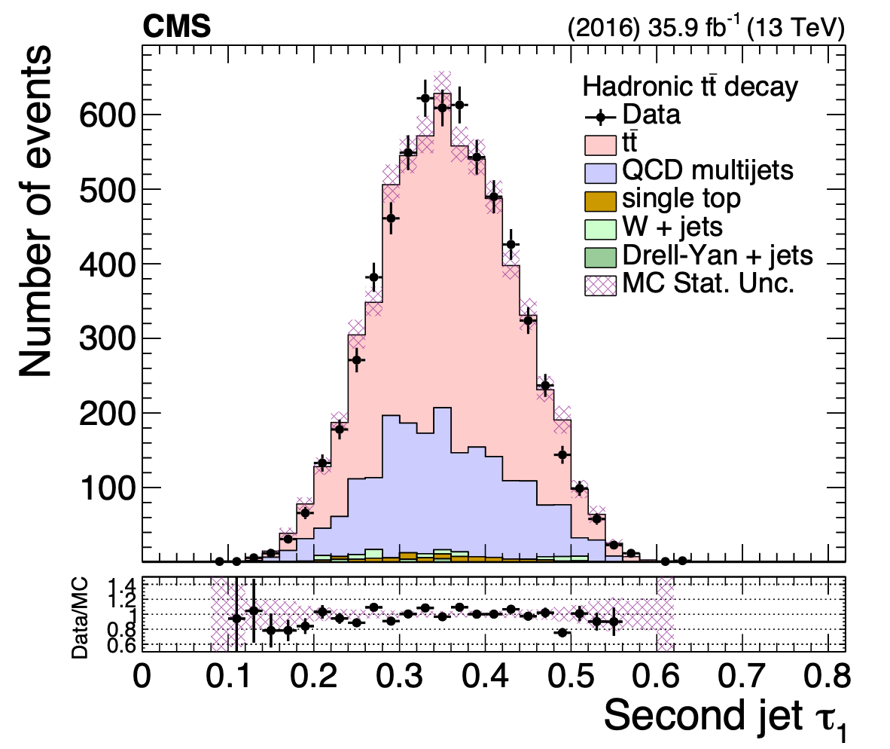
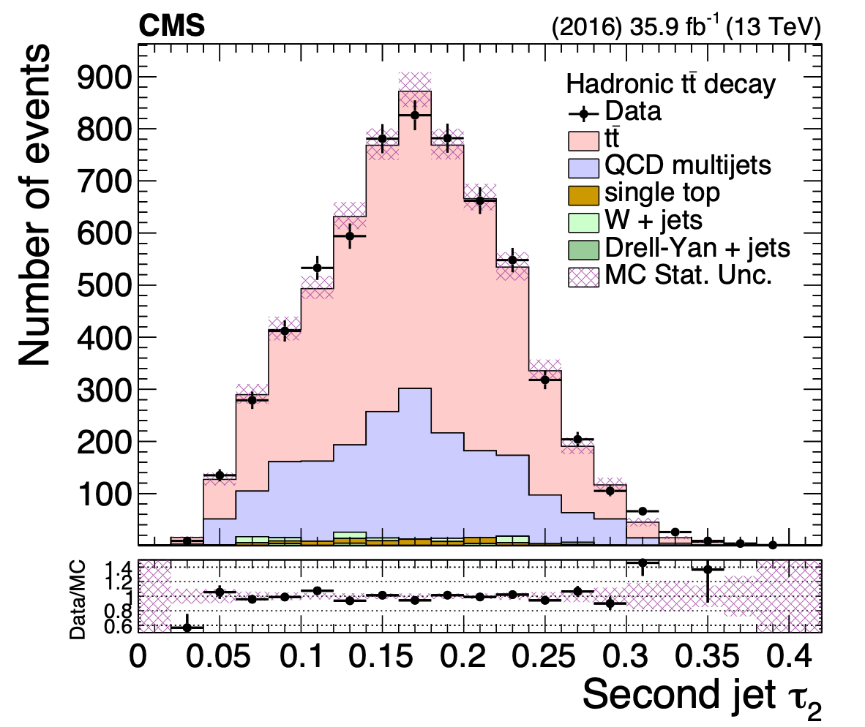
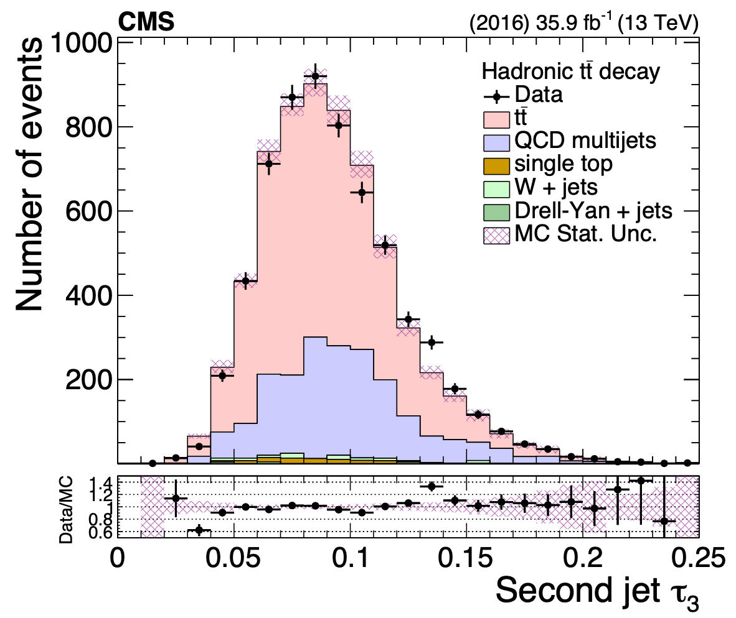
Substructure properties (after NN cut)

Slide 13
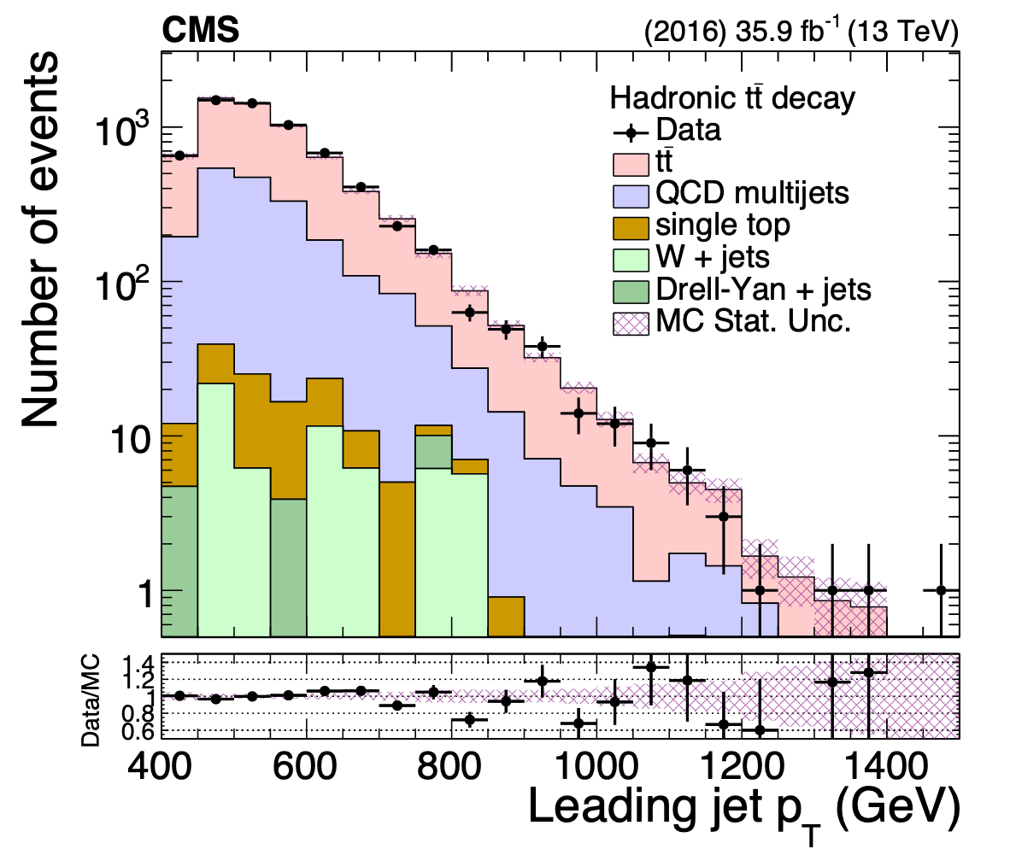
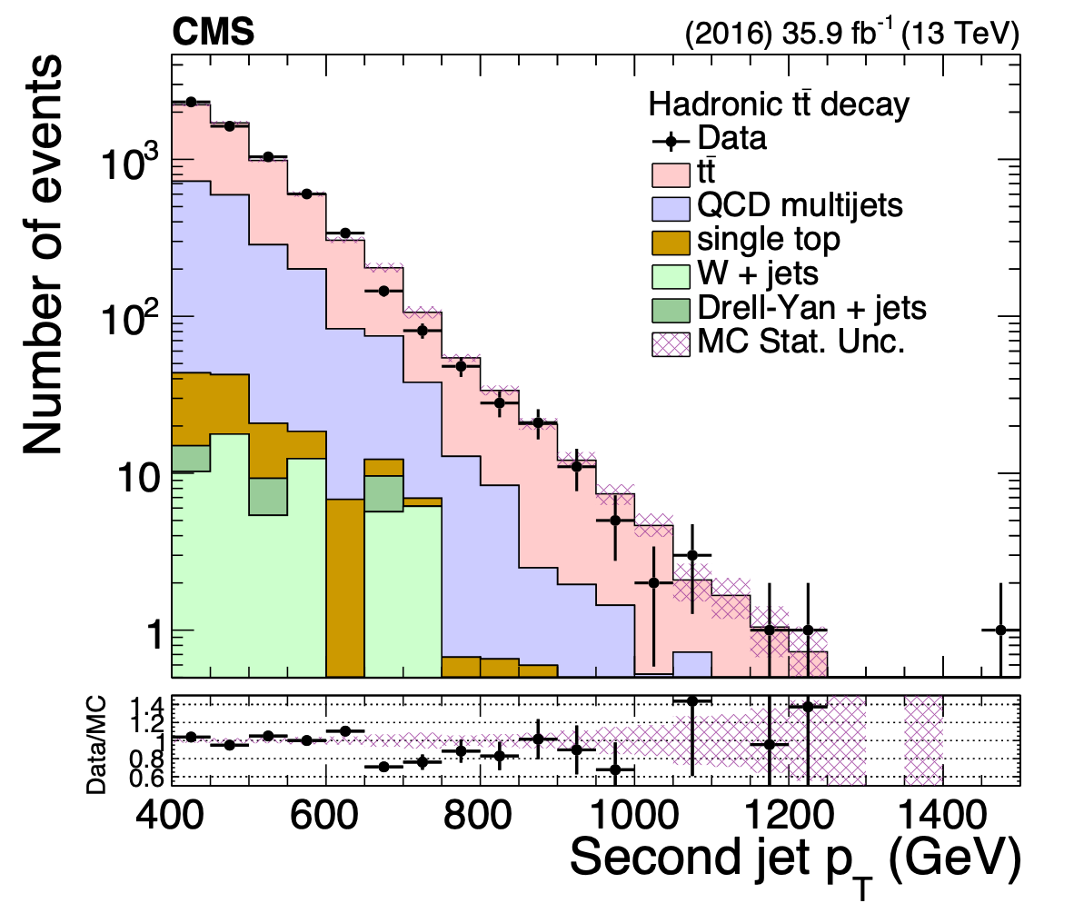
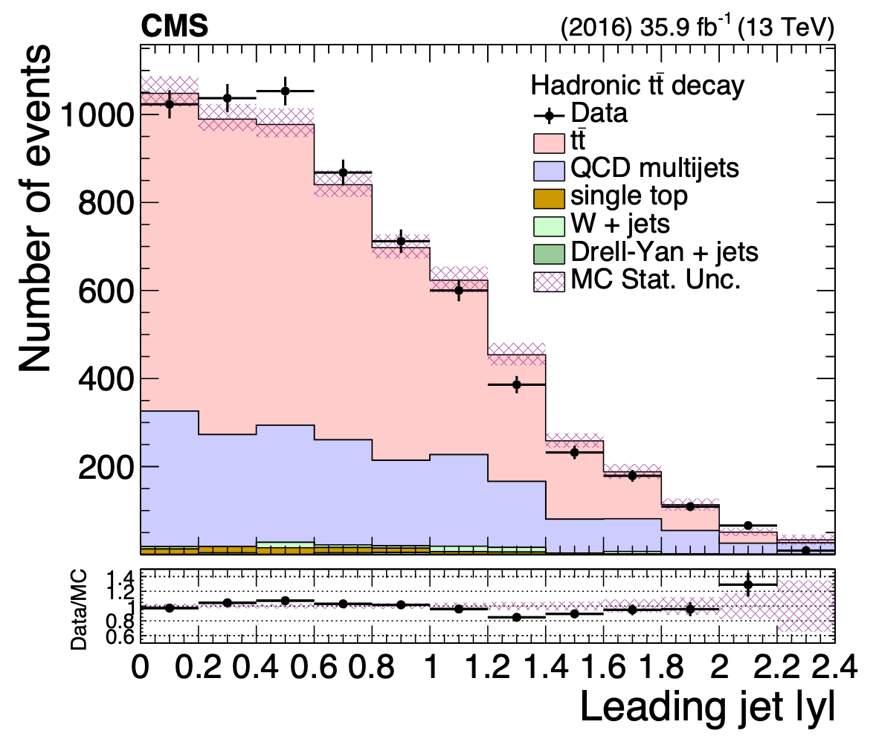
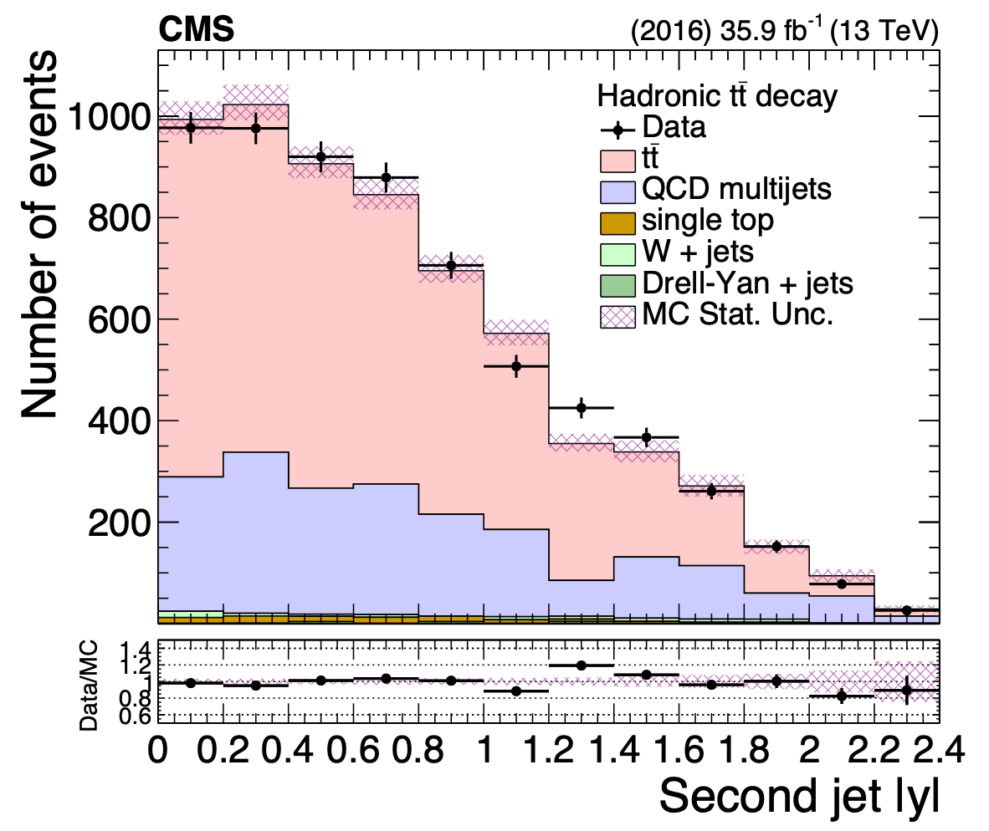
Top kinematic variables

Slide 14
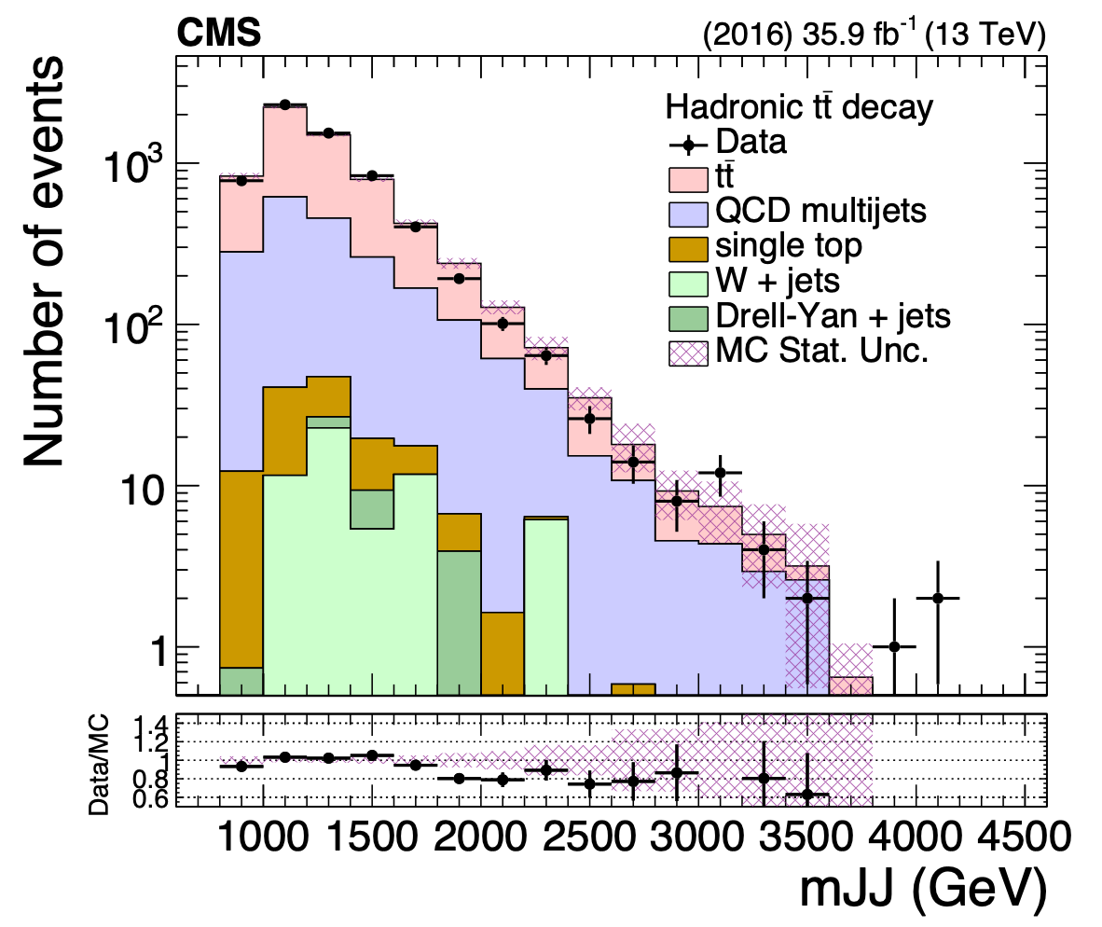
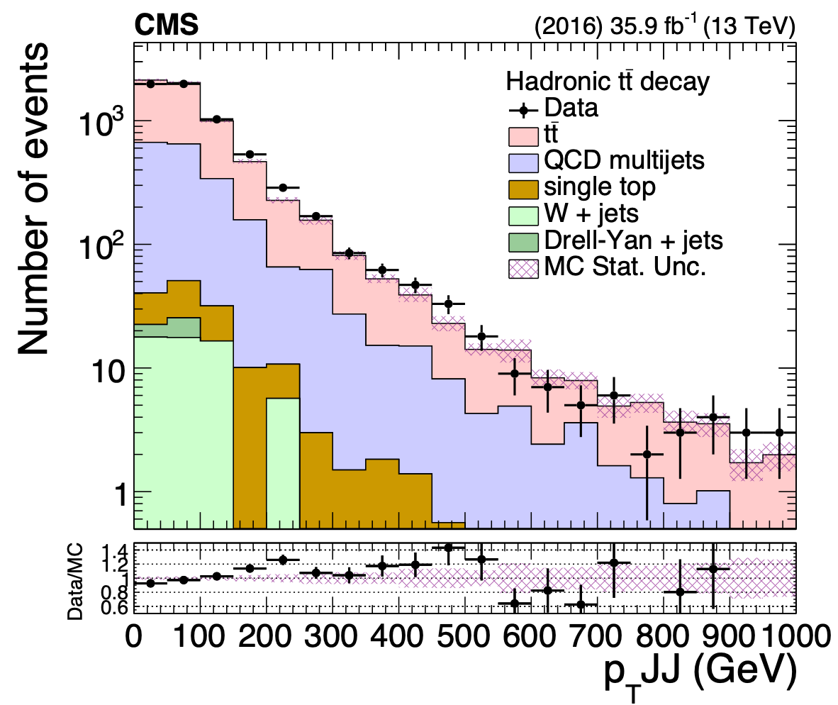
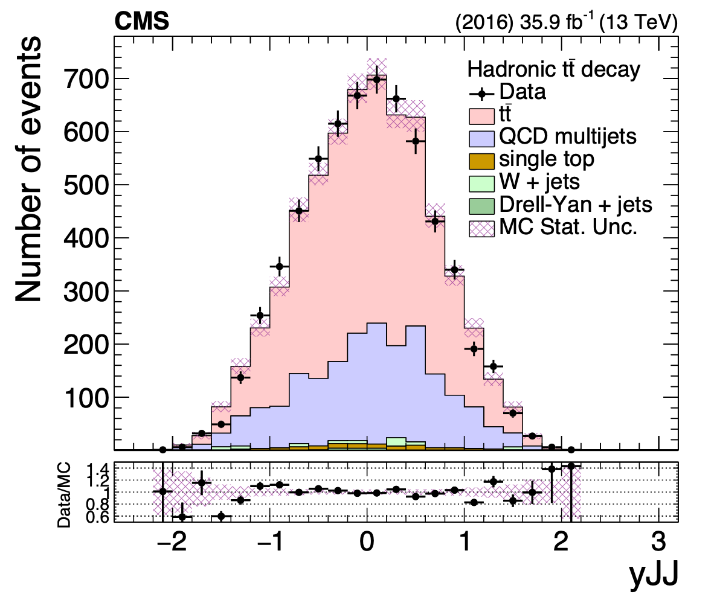
Top kinematic variables

Slide 15
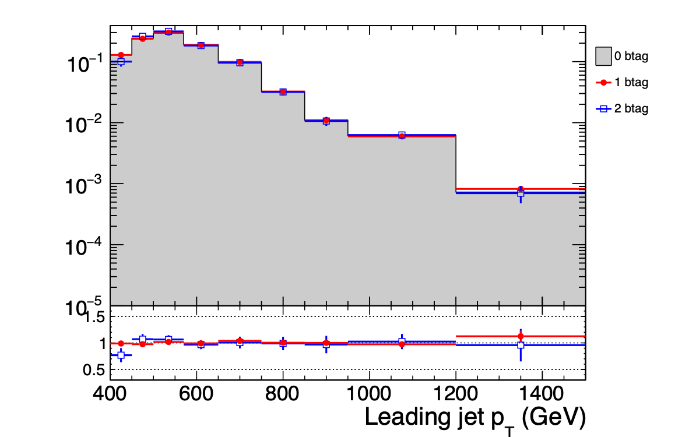
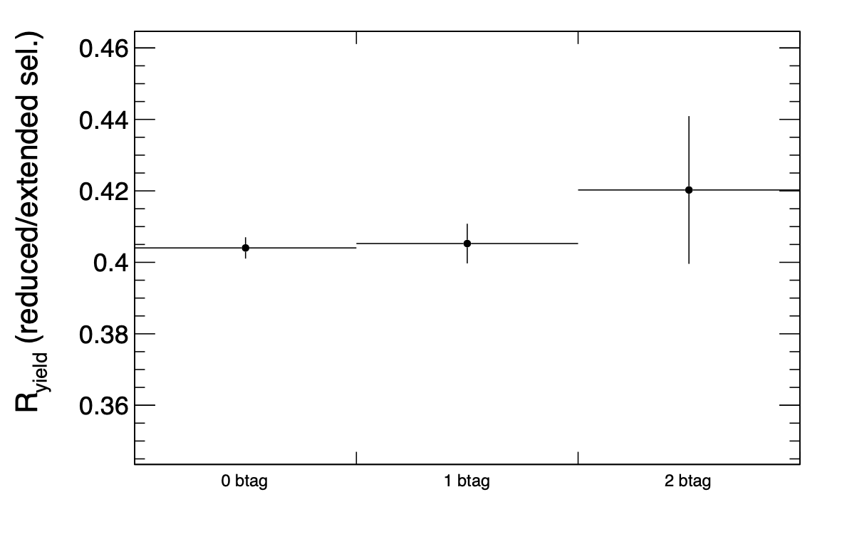
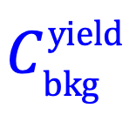
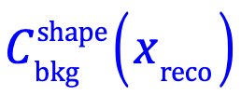
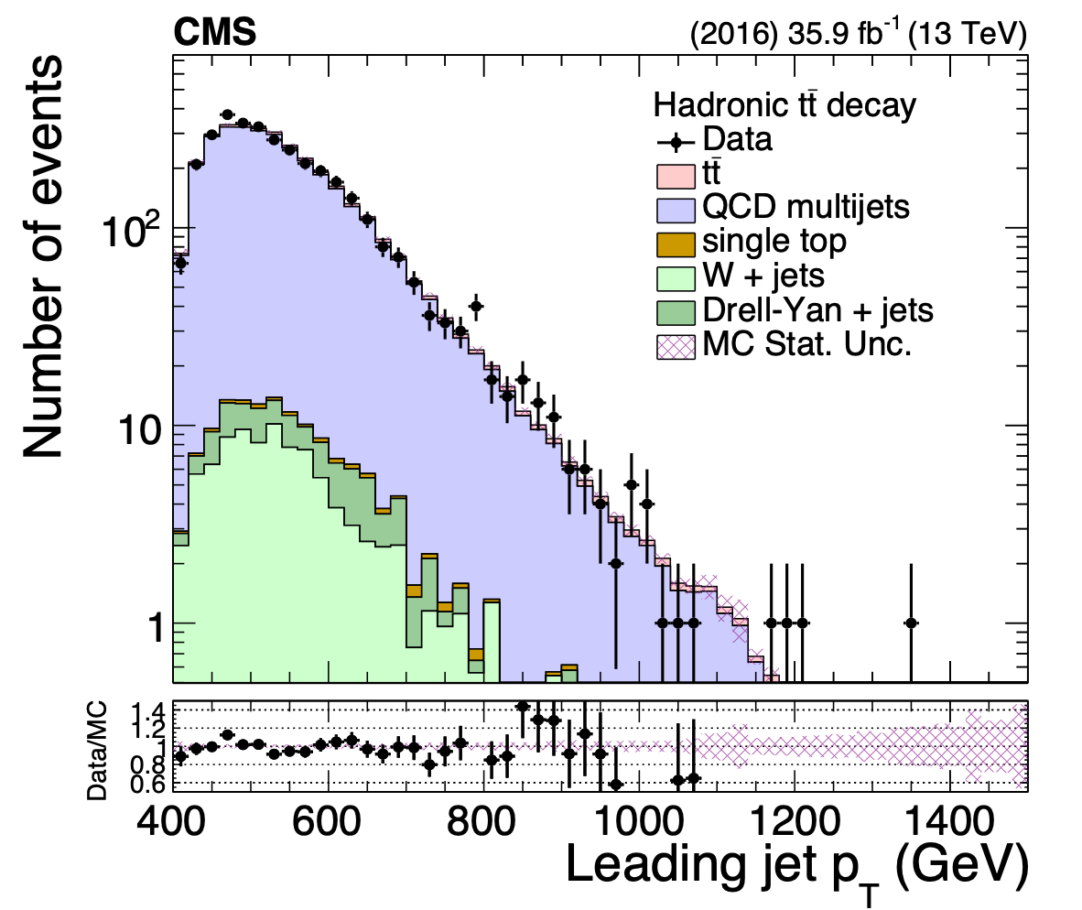
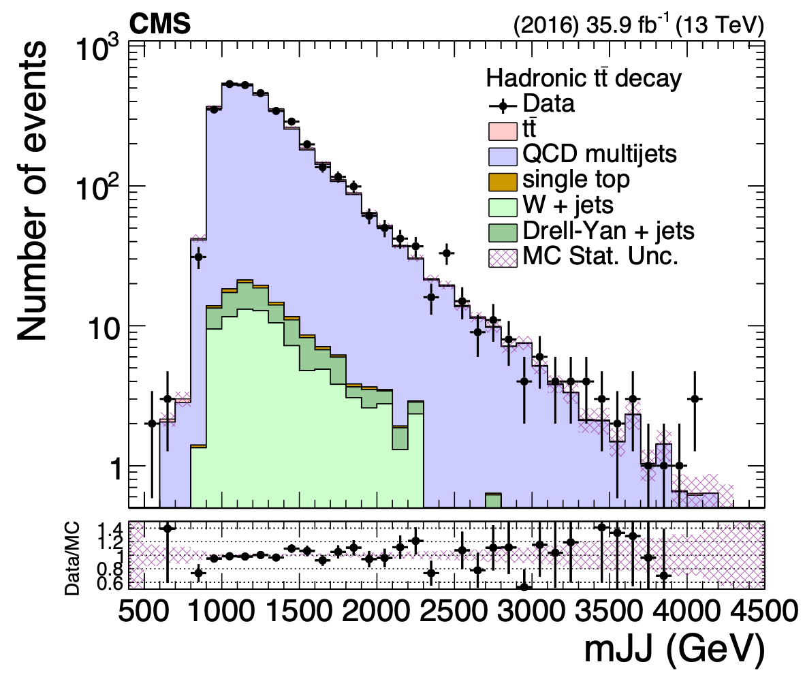
Validation of the background method
QCD MC
QCD MC
Negligible signal
contamination in 0-btag

Slide 16
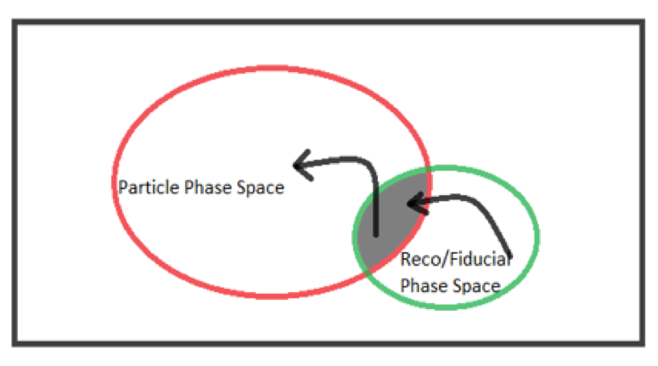
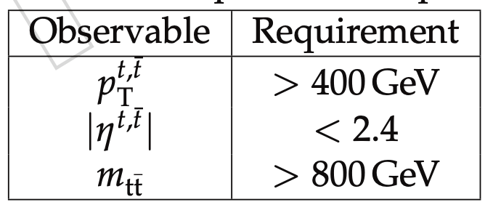
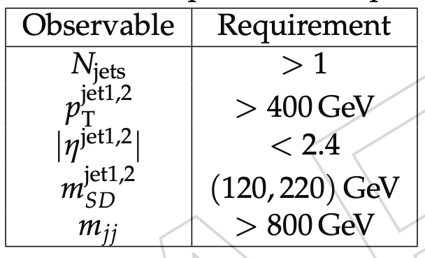
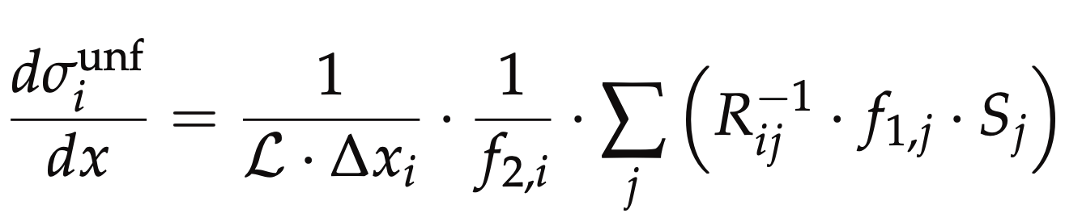
Parton & Particle levels
Particle
top candidates: AK8 genjets
Parton
efficiency of the reco+true selection
migration matrix
reco efficiency of the reco+true selection
Unfolding: simple response matrix inversion w/o regularisation

Slide 17
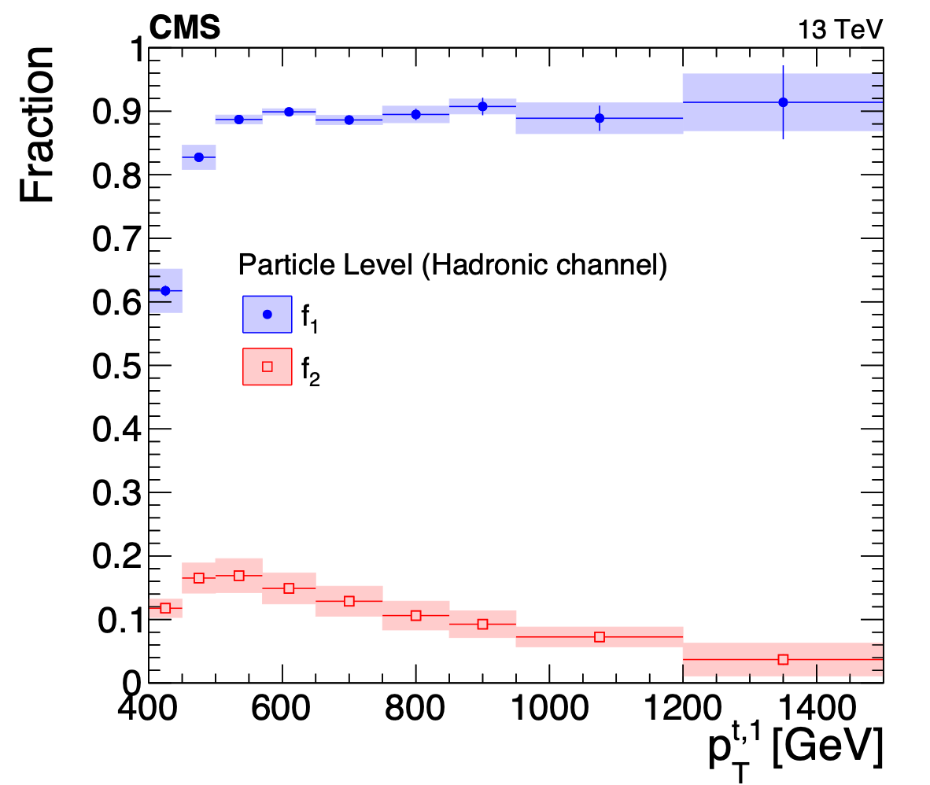




Fractions of particle & parton level definitions
f1: fraction of reco events in the reco+parton/particle phase space
paper
paper
f2: fraction of parton/particle events in the reco+parton/particle phase space
Particle to parton matching efficiency

Slide 18




Migration matrices
paper

Slide 19
Systematic uncertainties
Two categories:
Experimental: object performance between data and simulation
Theoretical: related to the simulation itself(acceptance, efficiency, migration matrix)
Experimental
QCD bkg prediction
Jet Energy Scale
Jet Energy Resolution
Subjet b-tagging efficiency
Pileup
Trigger
Luminosity
Theoretical: Divided into 2 groups
Matrix element of the hard process (variations of LHE event weights stored in nominal MC)
Modelling of the parton shower and the underlying event (dedicated, alternative MC samples)
Parton Distribution Functions
Renormalisation and factorisation scales:
Strong coupling constant
Final State Radiation (FSR): in situ constrained
Initial State Radiation (ISR)
Matrix Element-Parton showering matching
Underlying event tune

Slide 20




In situ constraint of the FSR uncertainty
Template fits with Combine
Fit suggests scale down with 0.25, we use 0.3

Slide 21




Uncertainties vs leading top pT
paper

Slide 22




Uncertainties vs leading top |y|
paper

